Slide 1
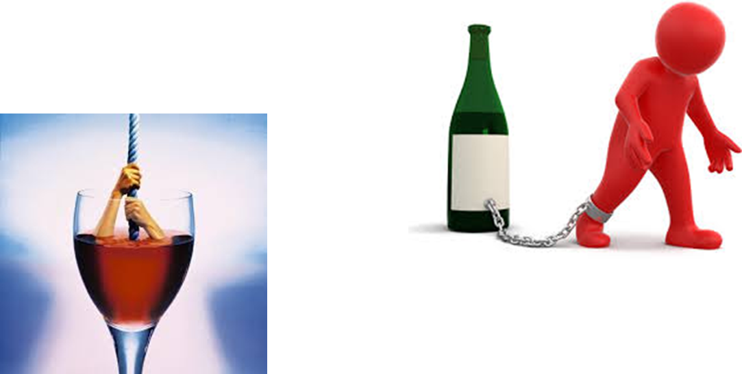

Alcoholism

Slide 2
Introduction
The problem of alcoholism, until a few decades ago, was considered a moral problem and a sign of social responsibility.
After the introduction of the prohibition policy in some states, it was viewed as an illegal act.
A lot of youth start as social drinkers and end up as alcoholics.

Slide 3
Conti..
An alcoholic is a person, while alcoholism is the illness. An alcoholic suffers from alcoholism. Alcoholism is a long-term (chronic) disease.
Alcoholism is a broad term for problems with alcohol, and generally it refers to compulsive and uncontrolled consumption of alcohol.
Alcoholism has much in common with the problem of drug abuse.

Slide 4
Behaviour of becoming alcoholic
Frequently drinking more than intended
Occasional or frequent blackouts
Frequently regretting things when drunk
Requiring more alcohol to get drunk
Drinking alone or in secret
Feeling the urge of drink
Hiding alcohol in your home, workplace, etc.,
Stopping or losing interest in hobbies
Missing work or other activities due to drinking
Neglecting responsibilities due to drinking

Slide 5
Causes of being an alcoholic
Social drinking
Alcoholic parents
Lack of family support
Low self esteem
Childhood sexual abuse
Stress
Peer drinking
Media and advertising
Availability etc..,

Slide 6
Effects of being an alcoholic
Long term alcohol abuse may cause a number of physical symptoms including
Cirrhosis of liver
Pancreatitis
Epilepsy
poly-neuropathy
Heart disease
Nutritional deficiencies
Peptic ulcer
Cardiovascular disease
cancer

Slide 7

Side effects of alcohol consumption

Slide 8
Tips to quit alcohol
Recognition of problem
Commit yourself
Set goals
Do not keep alcohol at home
Do not skip meals
Do maintain healthy diet
Do start exercising again
Do remember the heartache, that alcohol caused in you or others life
Do be thankful for many blessing that you already posses

Slide 9
Thank you

